Slide 1
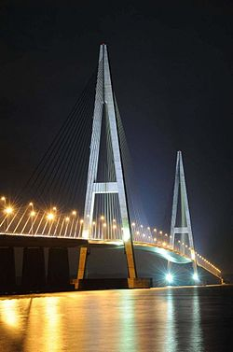
If you need a break from Melaka,
And go to the state of Johor,

Slide 2
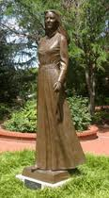
You will see a monument to a famous woman,
Who started her life quite poor.

Slide 3
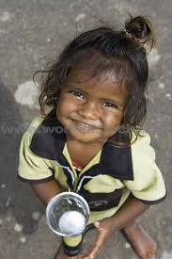
As a girl she was an orphan, abandoned on the street,
With no clothes on her back, and no shoes on her feet.

Slide 4
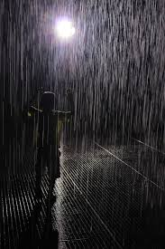
One dark, dreary night, in the cold, chilly rain,
At her moment of deepest despair and most profound pain,

Slide 5
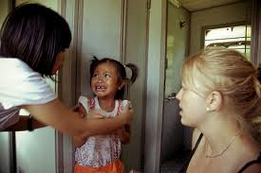
She met two kind women who dried her tears,
And helped her overcome her childhood fears.

Slide 6
“Study,” they said, “and you will succeed,”
“Then one day you too can help those in need.”

Slide 7
She was the best student her teachers had ever met,
An exam question that was too difficult they were unable to set.

Slide 8
She studied day and night, in the library without rest,

Slide 9
And she never asked to switch tutorials to study for a midterm test.

Slide 10
After she got a great job, she squirreled away her income,

Slide 11
So by the time she retired, the account contained a significant sum.

Slide 12
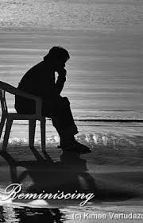
As she recalled that dark day when she was so sad,
She made a resolution to give all she had,

Slide 13
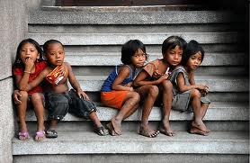
To other poor orphans she knew,
Who were also struggling and suffering in Johor Baru,

Slide 14
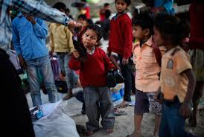
She could put shoes on their feet and clothes on their backs,
And as an added bonus, the money would be free from tax.

Slide 15
And the charity could last forever, as long as it was vested in trustees,
Then there would be no danger of violating, the rule against perpetuities.

Slide 16
So when you’re going south taking a break from the stress at MMU,

Slide 17
Take a look at her statue, and maybe she can inspire you to give something too.

