Slide 1
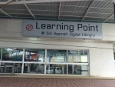
I entered Learning Point one late night,

Slide 2
There were a chill in the air and the moon was bright,

Slide 3
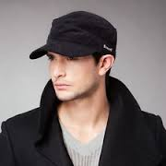
I turned my collar up and pulled my cap down low

Slide 4
Then aimed for youtube.com to watch my favorite TV show.

Slide 5
But before I could get online, my aim was cut short, As two students sat next to me, deep in conversation,

Slide 6
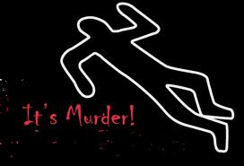
They didn’t get my attention, at least at first, Until I heard the words “murder” and “unlawful consideration.”

Slide 7
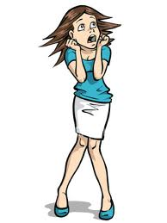
But will you be too afraid, too frightened if I continue? Because this is a story about a student and a killing at MMU.

Slide 8
I pulled my cap even lower, in my chair I settled in, And got comfortable, for the story was about to begin.

Slide 9
The students started by speaking slowly, but before long I could tell, That their story would gain urgency, as their voices quickly fell.

Slide 10
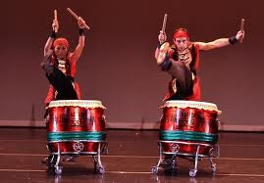
Last year, during Chinese New Year, the drums were a-pounding, Many guests were coming to celebrate, into the campus they were pouring,

Slide 11
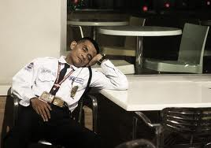
A stranger entered the back gate, the one near the football ground, The security guard was fast asleep, the stranger could hear him snoring.

Slide 12
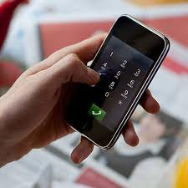
He got on his Samsung and dialed a secret number, And into the phone uttered a secret code,

Slide 13
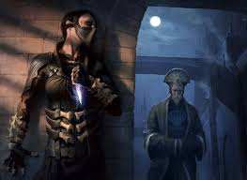
In that conversation, a deal was finished, Blood money, a paid hit, a life would be diminished.

Slide 14
“So do you want me to do it?” he asked, “Yes, kill him for 10,000, will you agree?” “I will, I shall, for such a fine fee.”

Slide 15
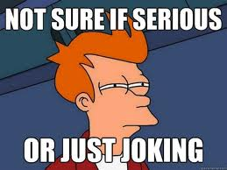
“But are you serious, or joking, is there true intention?” “Of course, such a strange question, why would you mention?”

Slide 16
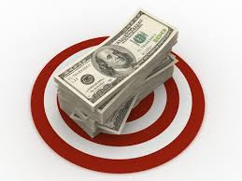
“And are you certain of the target and the amount?” “Yes, you are a strange killer, what are you talking about?”

Slide 17
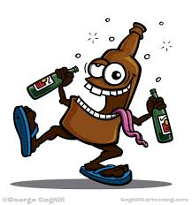
“But are you drunk, a minor or of unsound mind?” “Absolutely not. You are the oddest person I have been able to find!”

Slide 18
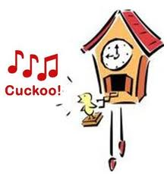
“Perhaps I am, but let me ask one more question. Is my service of value to you?” “Naturally. Are you a fool? I am starting to think you’re a bit cuckoo!”

Slide 19
“Ha ha,” the killer thought with excitement, joy and elation. “I have offer, acceptance, intention, certainty, capacity and consideration.”

Slide 20
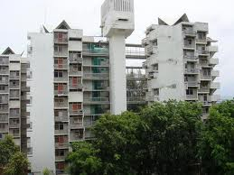
And so he proceeded with his dark, awful crime, As he climbed up the hostel, one step at a time.

Slide 21
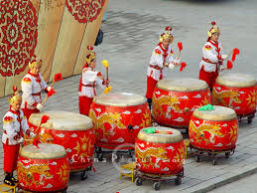
The Chinese drums were quickening, boom boom boom, The killer made his way stealthily, to the poor student’s room.

Slide 22
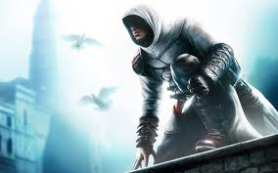
Crouching like a cat, about to catch its prey, He smiled at the job he would do and the money it would pay.

Slide 23
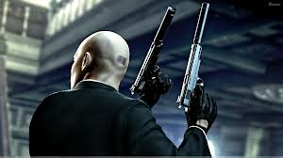
He leapt up onto the railing, and took out his gun, The contract had been made, and now it was time for his fun.

Slide 24
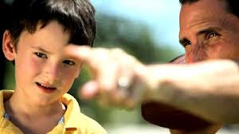
But the killer suddenly had a thought, his mind was swept away, To his own young son, what would he say?

Slide 25
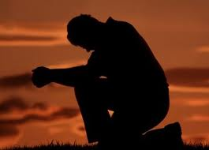
He got down from the railing, and went on one knee, Sobbing silently, he reached the CLC.

Slide 26
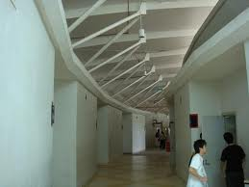
There he entered room 002, No one was around, so nobody knew,

Slide 27
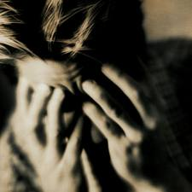
His mind was captured, with regret, suffering and grief, Of the life he had led, as a murderer and a thief.

Slide 28
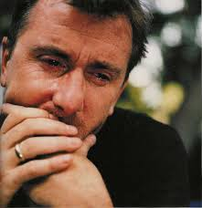
All night long and into the dawn, He cried until all his energy was gone.

Slide 29
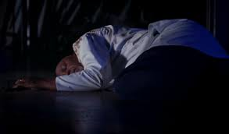
And the next day the cleaners found, The body of a stranger, lying dead in a puddle on the ground.

Slide 30
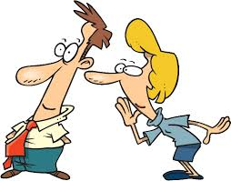
Keep it quiet, they agreed. The students will never guess, And make no announcement on MMLS!

Slide 31
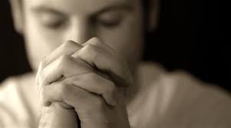
But the stranger had one last wish, that he prayed would be met,

Slide 32
That no matter what MMU did, with his tears the second row would always be wet.

